Slide 1
3.0 Fourier Series Representation of
Periodic Signals
3.1 Exponential/Sinusoidal Signals as
Building Blocks for Many Signals

Slide 2
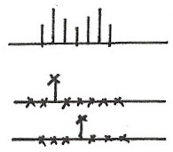
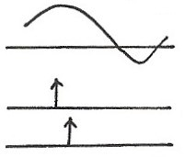
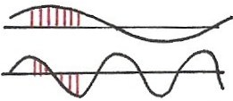




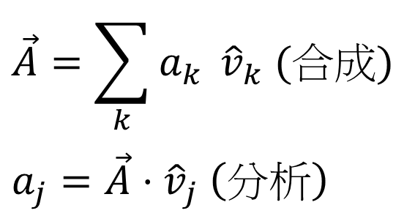










Time/Frequency Domain Basis Sets
Time Domain
$$x[n]$$
$$x(t)$$
$$n$$
$$t$$
$$t$$
$$n$$
$$t$$
$$n$$
$\{δ\left(t−τ\right), −∞<τ<∞\}$
$\{δ\left[n−k\right], k=0,±1,±2, ⋯\}$
Frequency Domain
$\{e^{jωt}, −∞<ω<∞\}$
$$\{e^{jωn},ω∈\left[0, 2π\right]\}$$
$$\vec{A}=\sum_{k}{a_{k} }{\hat{v}}_{k} (合成)$$
$$a_{j}=\vec{A}⋅{\hat{v}}_{j} \left(分析\right)$$
$t, n$
$t, n$

Slide 3
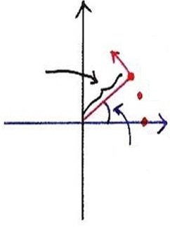
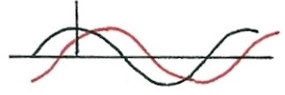
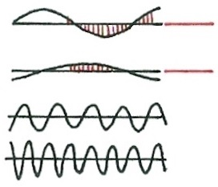












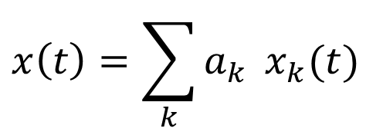










Signal Analysis
(P.32 of 1.0)
$$x\left(t\right)=\sum_{k}{a_{k}} x_{k}(t)$$
$$t=n$$
$$t=n$$
$$x_{k}\left(t\right)=Re\left\{ e^{jω_{k}t} \right\}={ \cos{ω}}_{k}t$$
$$a_{k}=A_{k}e^{jφ_{k}}$$
$$t=n$$
$$Re\left\{\left(A_{k}e^{jφ_{k}}\right) \left(e^{jω_{k}t}\right)\right\}=A_{k}\cos{(ω_{k}t+φ_{k})}$$
$$Im$$
$$n$$
$$ω_{k}$$
$$t$$
$$n$$
$$A_{k}$$
$$n=2$$
$$0$$
$$t$$
$$t$$
$$n=1$$
$$t$$
$$Re$$
$$ω_{k}=kω_{0}$$
$$t$$
$$n=0$$
$$φ_{k}$$

Slide 4
Response of A Linear Time-invariant
System to An Exponential Signal
Initial Observation
time-invariant
scaling property
0 t
if the input has a single frequency component, the output will be exactly the same single frequency component, except scaled by a constant

Slide 5



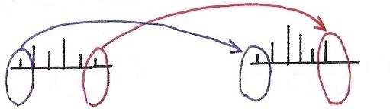














Input/Output Relationship
$$x(t)$$
$$y(t)$$
Time Domain
$$δ(t)$$
$$h(t)$$
$$t$$
$$t$$
0
0
Frequency Domain
$$ω$$
$$ω$$
$$ω_{1}$$
$$ω_{3}$$
$$ω_{5}$$
$$ω_{1}$$
$$ω_{3}$$
$$ω_{5}$$

Slide 6
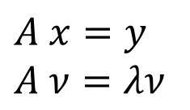
Response of A Linear Time-invariant
System to An Exponential Signal
More Complete Analysis
continuous-time
matrix
vectors
$$A x=y$$
$A ν=λν$
eigenvalue
eigenvector

Slide 7
Response of A Linear Time-invariant
System to An Exponential Signal
More Complete Analysis
continuous-time
Transfer Function
Frequency Response
: eigenfunction of any linear time-invariant
system
: eigenvalue associated with the eigenfunction e^{st}

Slide 8
Response of A Linear Time-invariant
System to An Exponential Signal
More Complete Analysis
discrete-time
Transfer Function
Frequency Response
eigenfunction, eigenvalue

Slide 9
System Characterization
Superposition Property
continuous-time
discrete-time
each frequency component never split to other frequency components, no convolution involved
desirable to decompose signals in terms of such eigenfunctions

Slide 10
3.2 Fourier Series Representation of
Continuous-time Periodic Signals
Fourier Series Representation
Harmonically related complex exponentials
T: fundamental period
all with period T

Slide 11
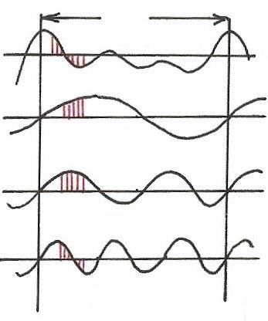
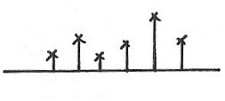






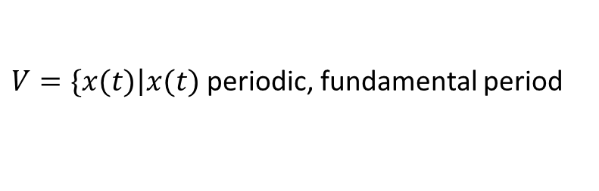






Harmonically Related Exponentials for Periodic Signals
$$[n]$$
T
$V=\{x(t)\left|x(t)\right.$ periodic, fundamental period
$$(N)$$
$$[n]$$
$$=T(N)\}$$
$$t, n$$
$$a_{4}$$
$$t, n$$
$$a_{1}$$
$$a_{3}$$
$$a_{5}$$
$$k=1$$
$$a_{0}$$
$$ω_{0}=\frac{2π}{T}$$
$$k$$
$$(N)$$
$$0 1 2 3 4 5$$
$$t, n$$
$$k=2$$
$$ω$$
$$0$$
$$ω_{0}$$
$${3ω}_{0}$$
$${5ω}_{0}$$
$$t, n$$
$${2ω}_{0}$$
$${4ω}_{0}$$
$$k=3$$
All with period T: integer multiples of ω₀
Discrete in frequency domain
$$(N)$$

Slide 12
Fourier Series Representation
Fourier Series
: j-th harmonic components
real

Slide 13
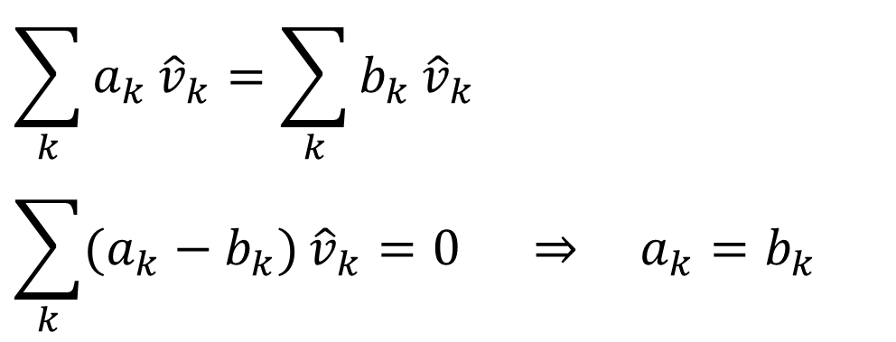



Real Signals
$${\left[⋯a_{−2} e^{−j2ω_{0}t}+a_{−1} e^{−jω_{0}t}+a_{0}+a_{1} e^{jω_{0}t}+a_{2} e^{j2ω_{0}t}⋯\right]}^{∗}$$
$$∥$$
$$a_{2}^{∗}$$
$$e^{−j2ω_{0}t}$$
For orthogonal basis:
$$\sum_{k}{a_{k}}{\hat{v}}_{k}=\sum_{k}{b_{k}}{\hat{v}}_{k}$$
$$\sum_{k}{(a_{k}−b_{k})}{\hat{v}}_{k}=0 ⇒ a_{k}=b_{k}$$
(unique representation)

Slide 14
Fourier Series Representation
Determination of a_{k}
Fourier series coefficients
dc component

Slide 15



$$\overset{⃑}{A}⋅{\hat{v}}_{n}=(\sum_{k}{a_{k}}{\hat{v}}_{k})⋅{\hat{v}}_{n}$$
$${\hat{v}}_{k}⋅{\hat{v}}_{n}=\left\{\begin{aligned} T, k=n \\ 0,k≠n\end{aligned}\right.$$
Not unit vector
orthogonal
$$\overset{⃑}{A}⋅{\hat{v}}_{n}=Ta_{n}$$
$$a_{n}=\frac{1}{T}(\overset{⃑}{A}⋅{\hat{v}}_{n})$$
(分析)

Slide 16
Fourier Series Representation
Vector Space Interpretation
vector space
could be a vector space
some special signals (not concerned here) may need to be excluded

Slide 17
Fourier Series Representation
Vector Space Interpretation
orthonormal basis
is a set of orthonormal basis expanding a vector space of periodic signals with period T

Slide 18
Fourier Series Representation
Vector Space Interpretation
Fourier Series

Slide 19
Fourier Series Representation
Completeness Issue
Question: Can all signals with period T be represented this way?
Almost all signals concerned here can, with exceptions very often not important

Slide 20
Fourier Series Representation
Convergence Issue
consider a finite series
It can be shown
a_{k} obtained above is exactly the value needed even for a finite series

Slide 21
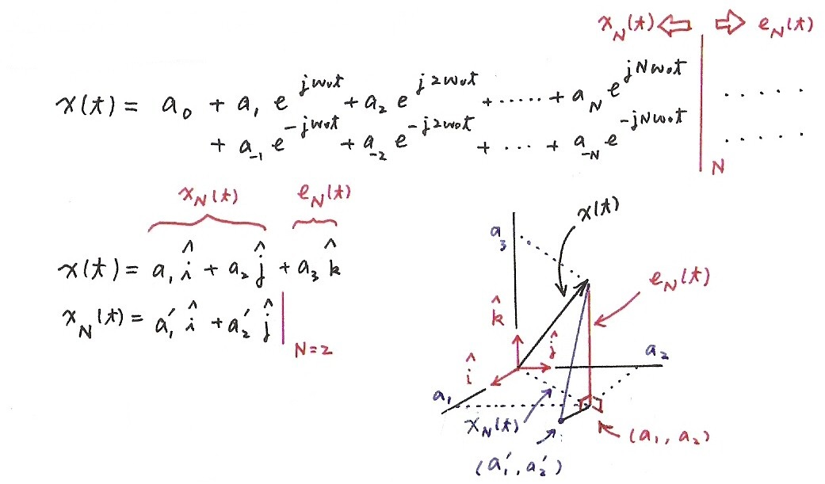

Truncated Dimensions
$a_{1}^{′}=a_{1}$, $a_{2}^{′}=a_{2}$,
for orthogonal $\hat{i }$, $\hat{j }$, $\hat{k}$
All truncated dimensions are orthogonal to the subspace of dimensions kept.

Slide 22
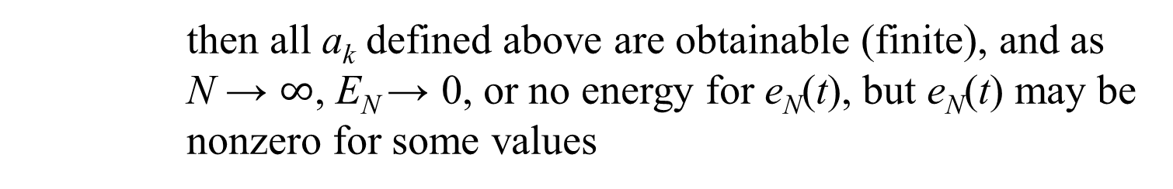
Fourier Series Representation
Convergence Issue
It can be shown

Slide 23
Fourier Series Representation
Gibbs Phenomenon
the partial sum in the vicinity of the discontinuity exhibit ripples whose amplitude does not seem to decrease with increasing N
See Fig. 3.9, p.201 of text

Slide 24
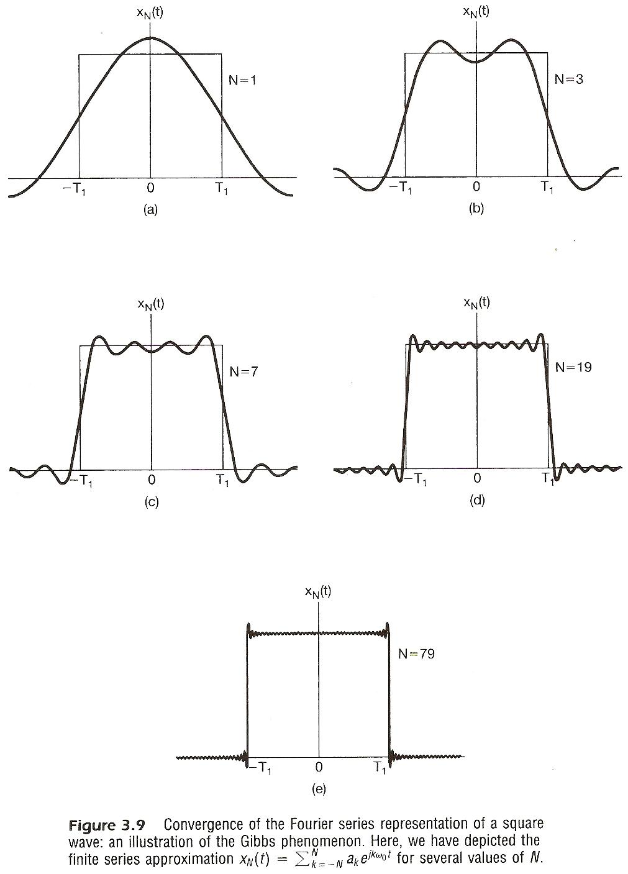

Slide 25
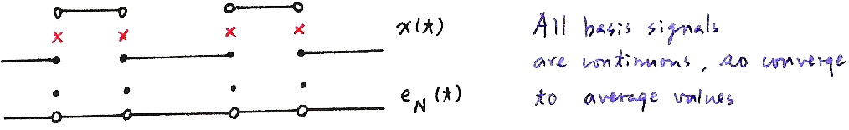
Fourier Series Representation
Convergence Issue
x(t) has no discontinuities
Fourier series converges to x(t) at every t
x(t) has finite number of discontinuities in each period
Fourier series converges to x(t) at every t except at the discontinuity points, at which the series converges to the average value for both sides
All basis signals are continuous, so converge to average values

Slide 26
Fourier Series Representation
Convergence Issue
Dirichlet’s condition for Fourier series expansion
(1) absolutely integrable, 
(2) finite number of maxima & minima in a period
(3) finite number of discontinuities in a period

Slide 27
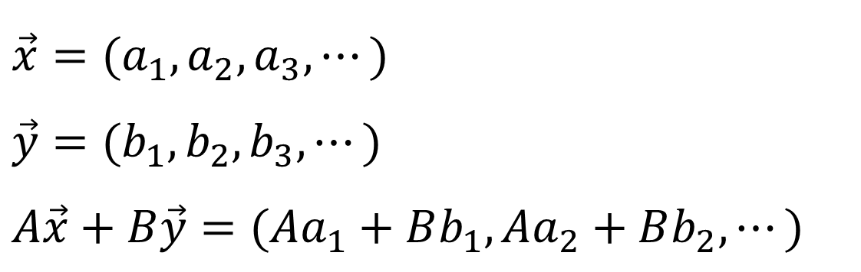
3.3 Properties of Fourier Series
Linearity
$$\vec{x}=(a_{1},a_{2},a_{3},⋯)$$
$$\vec{y}=(b_{1},b_{2},b_{3},⋯)$$
$$A\vec{x}+B\vec{y}=(Aa_{1}+Bb_{1},Aa_{2}+Bb_{2},⋯)$$

Slide 28
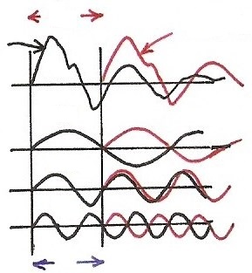










Time Shift
phase shift linear in frequency with amplitude unchanged
$$a_{k} e^{jkω_{0}(t−t_{0})}=e^{−jkω_{0}t_{0}} a_{k} e^{jkω_{0}t}$$
$$t_{0}$$
$${x(t−t}_{0})$$
$$x(t)$$
$$π$$
$$ω_{0}$$
$$2π$$
$${2ω}_{0}$$
$$3π$$
$${3ω}_{0}$$
$${kω}_{0}t_{0}$$

Slide 29

Time Reversal
the effect of sign change for x(t) and a_{k} are identical
$$⋯a_{−1} e^{−jω_{0}t}+a_{0}+a_{1} e^{jω_{0}t}+⋯=x(t)$$
$$⋯a_{−1} e^{jω_{0}t}⋯=x(−t)$$
unique representation for orthogonal basis

Slide 30
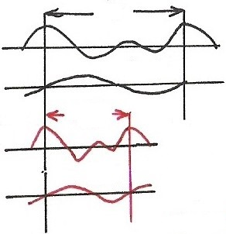



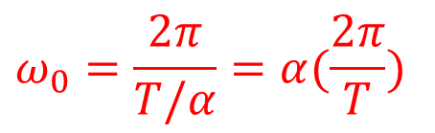




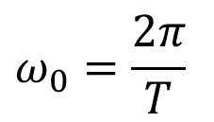
Time Scaling
positive real number
periodic with period T/α and fundamental frequency αω₀
a_{k} unchanged, but x(αt) and each harmonic component are different
$$T$$
$$x(t)$$
$$ω_{0}=\frac{2π}{T}$$
$$k=1$$
$$T/α$$
$$α>1$$
$$x(αt)$$
$$k=1$$
$$ω_{0}=\frac{2π}{T/α}=α(\frac{2π}{T})$$

Slide 31
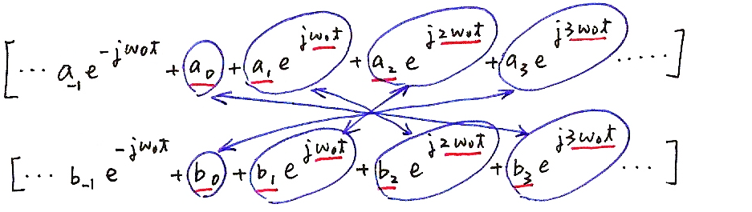


Multiplication
$$\underset{}{\underbrace{(⋯,a_{0}b_{3}+a_{1}b_{2}+a_{2}b_{1}+a_{3}b_{0},⋯)}e^{j3ω_{0}^{}t}}$$
$$d_{3}=\sum_{j}{a_{j}b_{3−j}}$$

Slide 32



Conjugation
$${\left[⋯a_{−1} e^{−jω_{0}t}+a_{0}+a_{1} e^{jω_{0}t}+⋯\right]}^{∗}$$
$$a_{−1}^{∗}$$
$$e^{jω_{0}t}$$
unique representation

Slide 33
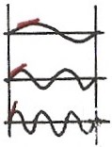
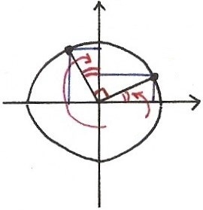
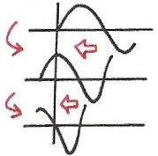
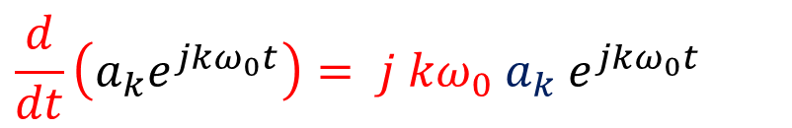

















Differentiation
$$k=1$$
$$\frac{d}{dt}\left(a_{k}e^{jkω_{0}t}\right)= j {kω}_{0} a_{k} e^{jkω_{0}t}$$
$$k=2$$
$$= =$$
$$k=3$$
$$j⋅[\cos{ω_{0}t}+j\sin{ω_{0}t}]$$
$$Im$$
$$\frac{d}{dt}$$
$$\frac{d}{dt}$$
$$=−\sin{ω_{0}t}+j\cos{ω_{0}t}$$
$$ω_{0}t$$
$$Re$$
$$\frac{d}{dt}$$
$$\sin{ωt}$$
$$j=e^{j{90}^{∘}}$$
$$\cos{ωt}$$
$$\frac{d}{dt}$$
$$−sin{ωt}$$

Slide 34
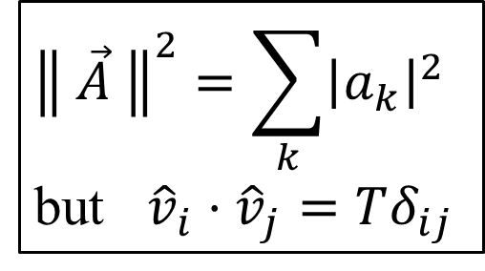
Parseval’s Relation
$${\left\| \vec{A} \right\|}^{2}=\sum_{k}{{\left|a_{k}\right|}^{2}}$$
but ${\hat{v}}_{i}⋅{\hat{v}}_{j}=Tδ_{ij}$
total average power in a period T
average power in the k-th harmonic component in a period T

Slide 35
3.4 Fourier Series Representation of
Discrete-time Periodic Signals
Fourier Series Representation
Harmonically related signal sets
, periodic with fundamental period N
all with period
only N distinct signals in the set

Slide 36
Harmonically Related Exponentials for Periodic Signals
(P. 11 of 3.0)
$$[n]$$
T
$V=\{x(t)\left|x(t)\right.$ periodic, fundamental period
$$(N)$$
$$[n]$$
$$=T(N)\}$$
$$t, n$$
$$a_{4}$$
$$t, n$$
$$a_{1}$$
$$a_{3}$$
$$a_{5}$$
$$k=1$$
$$a_{0}$$
$$ω_{0}=\frac{2π}{T}$$
$$k$$
$$(N)$$
$$0 1 2 3 4 5$$
$$t, n$$
$$k=2$$
$$ω$$
$$0$$
$$ω_{0}$$
$${3ω}_{0}$$
$${5ω}_{0}$$
$$t, n$$
$${2ω}_{0}$$
$${4ω}_{0}$$
$$k=3$$
All with period T: integer multiples of ω₀
Discrete in frequency domain
$$(N)$$

Slide 37
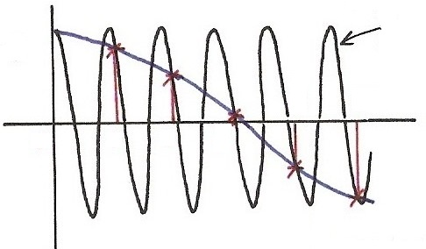
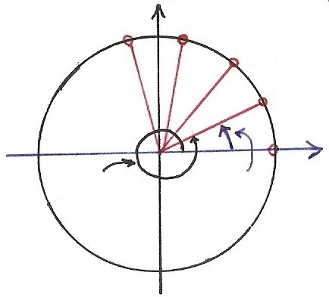
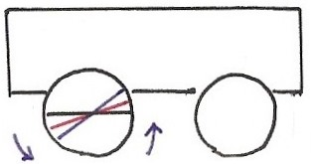
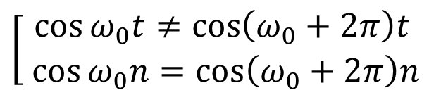






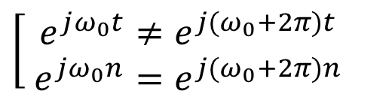

Continuous/Discrete Sinusoidals
(P.36 of 1.0)
$$\cos{[\left(ω_{0}+2π\right)t]}$$
$$(t=n)$$
$$\cos{[⋅]}$$
$$\left[\begin{aligned}\cos{ω_{0}t}≠\cos\left(ω_{0}+2π\right)t \\ \cos{ω_{0}n}=\cos\left(ω_{0}+2π\right)n\end{aligned}\right.$$
4
5
$$t,n$$
0
1
2
3
$$\left[\begin{aligned} e^{jω_{0}t}≠e^{j{(ω}_{0}+2π)t} \\ e^{jω_{0}n}=e^{j{(ω}_{0}+2π)n}\end{aligned}\right.$$
$$\cos{[ω_{0}t]}$$
$$(t=n)$$
$$Im$$
$$n=4$$
$$n=3$$
$$n=2$$
$$e^{j[⋅]}$$
$$n=1$$
$$Re$$
$$ω_{0}t$$
$$n=0$$
$${(ω}_{0}+2π)t$$

Slide 38
Exponential/Sinusoidal Signals
Harmonically related discrete-time signal sets
all with common period N
This is different from continuous case. Only N distinct signals in this set.
(P.42 of 1.0)

Slide 39
Fourier Series Representation
Determination of a_{k}
(P.14 of 3.0)
Fourier series coefficients
dc component

Slide 40
(P.15 of 3.0)
$$\overset{⃑}{A}⋅{\hat{v}}_{n}=(\sum_{k}{a_{k}}{\hat{v}}_{k})⋅{\hat{v}}_{n}$$
$${\hat{v}}_{k}⋅{\hat{v}}_{n}=\left\{\begin{aligned} T, k=n \\ 0,k≠n\end{aligned}\right.$$
Not unit vector
orthogonal
$$\overset{⃑}{A}⋅{\hat{v}}_{n}=Ta_{n}$$
$$a_{n}=\frac{1}{T}(\overset{⃑}{A}⋅{\hat{v}}_{n})$$
(分析)

Slide 41

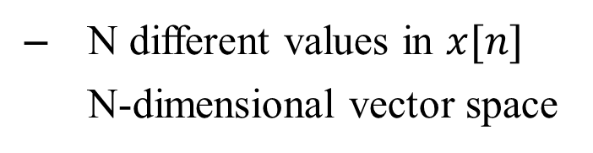
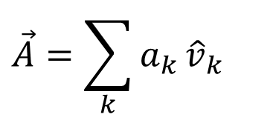
Fourier Series Representation
Fourier Series
repeat with period N
Note: both x[n] and a_{k} are discrete, and periodic with period N, therefore summed over a period of N
$$\vec{A}=\sum_{k}{a_{k}}{\hat{v}}_{k}$$
(合成)
$$a_{k}=\vec{A}⋅{\hat{v}}_{k}$$
(分析)
N different values in $x[n]$
N-dimensional vector space

Slide 42


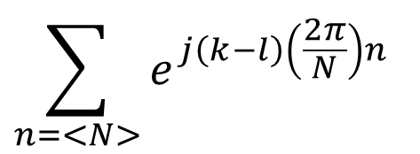
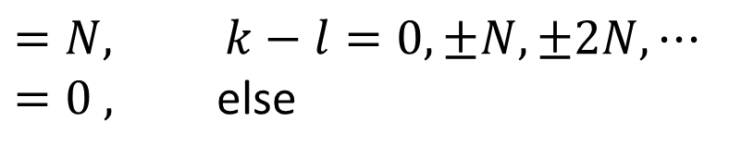
Orthogonal Basis
$$\sum_{n=<N>}{e^{j\left(k−l\right)\left(\frac{2π}{N}\right)n}}$$
$$=N, k−l=0, ±N, ±2N,⋯$$
$=0 ,$ else
$$∥$$
$$\left[e^{jk(2π/N)n}\right]⋅\left[e^{jl(2π/N)n}\right]={\hat{v}}_{k}⋅{\hat{v}}_{l}$$

Slide 43
Fourier Series Representation
Vector Space Interpretation
is a vector space

Slide 44
Fourier Series Representation
Vector Space Interpretation
a set of orthonormal bases

Slide 45
Fourier Series Representation
No Convergence Issue, No Gibbs Phenomenon,
No Discontinuity
x[n] has only N parameters, represented by N coefficients
sum of N terms gives the exact value
N odd – N even
See Fig. 3.18, P.220 of text

Slide 46
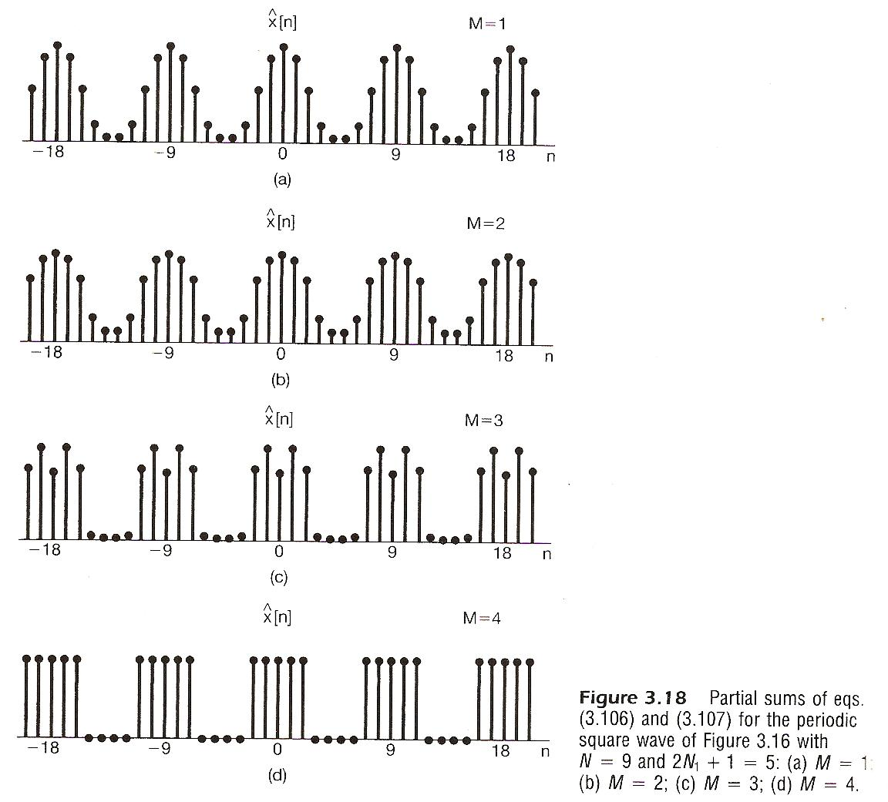

Slide 47
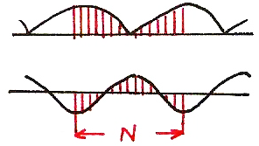




Properties
Primarily Parallel with those for continuous-time
Multiplication
periodic convolution
$$a_{j}$$
$$j$$
$$b_{k−j}$$
$$j$$

Slide 48
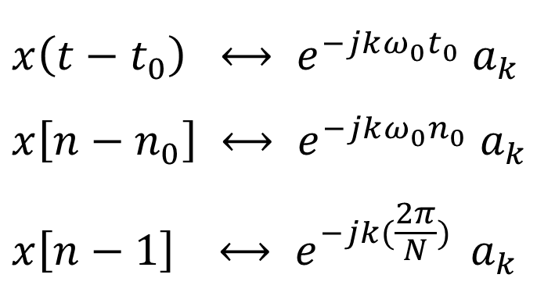
Time Shift
$${x\left(t−t_{0}\right) ⟷ e}^{−jkω_{0}^{}t_{0}^{}} a_{k}$$
$${x\left[n−n_{0}\right] ⟷ e}^{−jkω_{0}^{}n_{0}^{}} a_{k}$$
$${x\left[n−1\right] ⟷ e}^{−jk(\frac{2π}{N}) } a_{k}$$
First Difference

Slide 49
Properties
Parseval’s Relation
average power in a period
average power in a period for each harmonic component

Slide 50
3.5 Application Example
System Characterization
x[n], x(t)
δ[n], δ(t)
y[n], y(t)
h[n], h(t)
z^{n} , e ^{st} H(z)z^{n}, H(s)e^{st}, z=e ^{jω}, s=jω
e ^{jωn} , e ^{jωt} H(e ^{jω})e ^{jωn}, H(jω)e ^{jωt}
n
n
ω
ω

Slide 51
Superposition Property
Continuous-time
Discrete-time
H(jω), H(e^{jω}) frequency response, or transfer function

Slide 52
Filtering
modifying the amplitude/ phase of the different frequency components in a signal, including eliminating some frequency components entirely
frequency shaping, frequency selective
Example 1
See Fig. 3.34, P.246 of text

Slide 53
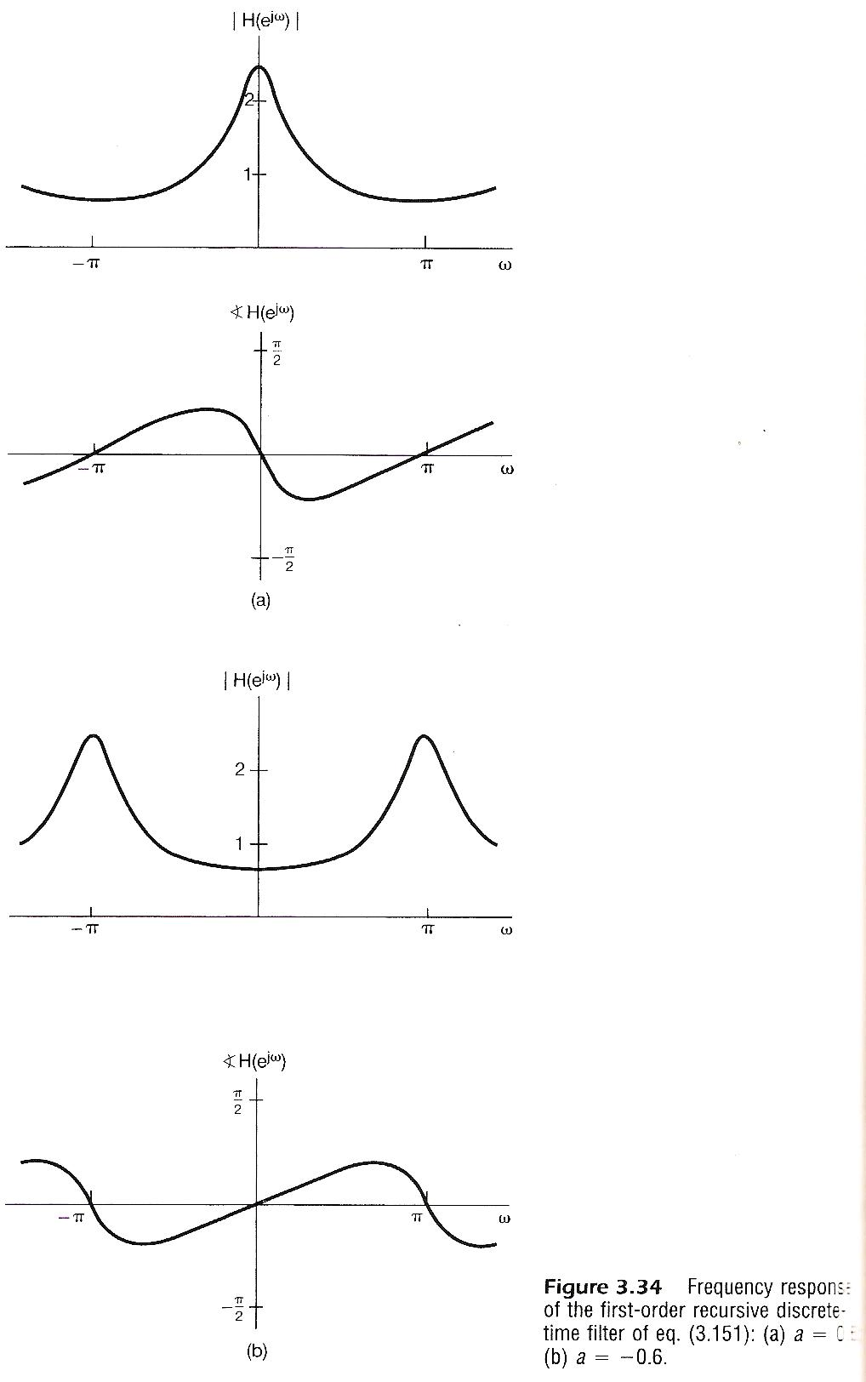

Slide 54
Filtering
Example 2
See Fig. 3.36, P.248 of text

Slide 55
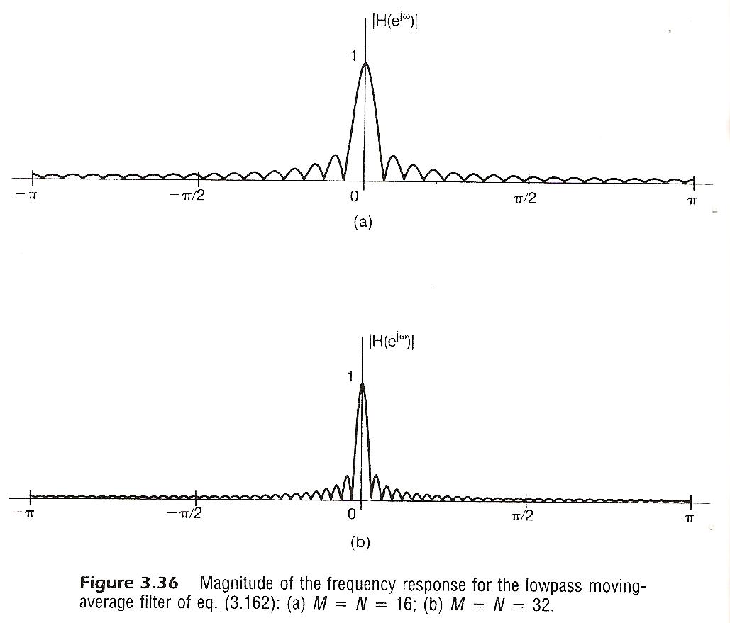

Slide 56
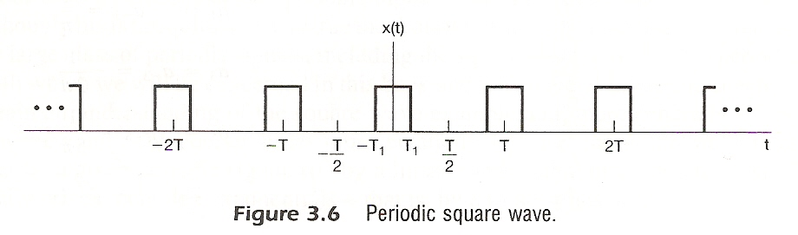
Examples
Example 3.5, p.193 of text

Slide 57
Examples
Example 3.5, p.193 of text

Slide 58
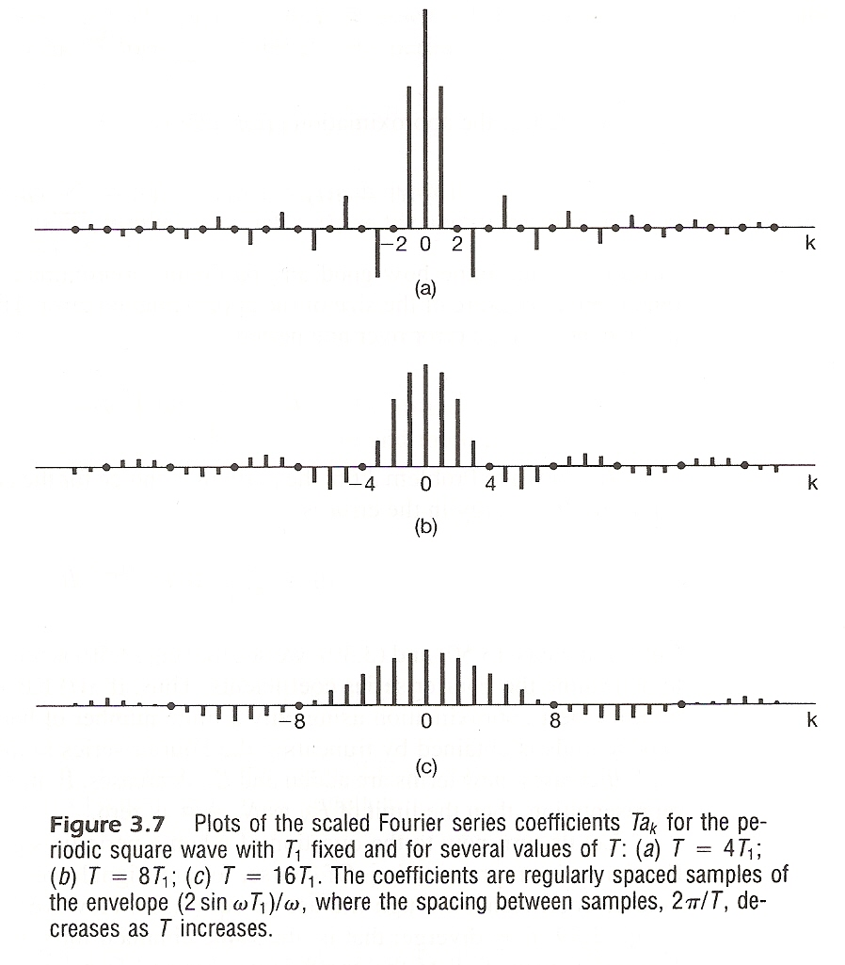
Examples
Example 3.5, p.193 of text
(a)
(b)
(c)

Slide 59
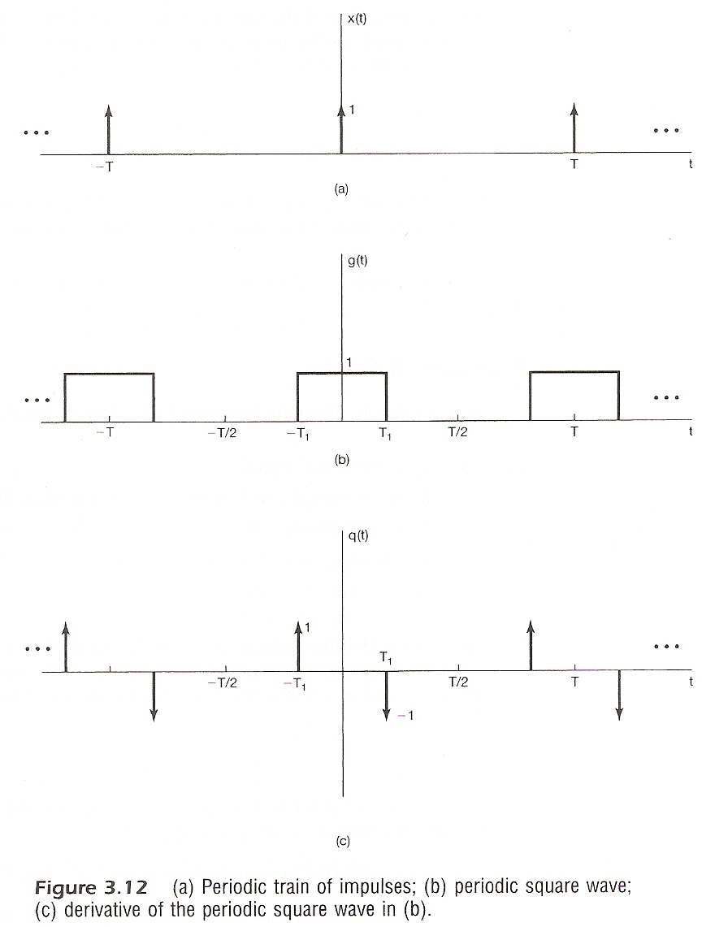



Examples
Example 3.8, p.208 of text
$$x(t)⟶a_{k}$$
(a)
(b)
(c)
$$g(t)⟶c_{k}$$
$$q(t)⟶b_{k}$$

Slide 60
Examples
Example 3.8, p.208 of text

Slide 61
Examples
Example 3.17, p.230 of text
x[n]
y[n]
x[n], x(t)
δ[n], δ(t)
y[n], y(t)
h[n], h(t)
h[n]

Slide 62
Problem 3.66, p.275 of text
.
.
.

Slide 63
Problem 3.70, p.281 of text
2-dimensional signals

Slide 64
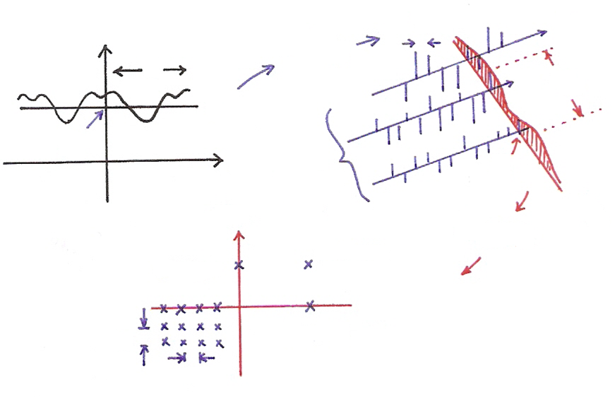





















Problem 3.70, p.281 of text
2-dimensional signals
$$t_{2}$$
$$ω_{10}$$
$$ω_{1}$$
$${FS}_{({\overline{t}}_{2})}$$
$$T_{1}$$
$$ω_{1}$$
$$t_{1}$$
$$T_{2}$$
$${\overline{t}}_{2}$$
$$t_{1}$$
different
$${\overline{ω}}_{1}$$
$${\overline{t}}_{2}$$
$$ω_{2}$$
$$t_{2}$$
$$(0,ω_{2})$$
$$(ω_{1},ω_{2})$$
$${FS}_{({\overline{ω}}_{1})}$$
$$ω_{1}$$
$$ω_{20}$$
$$(ω_{1},0)$$
$$ω_{10}$$

Slide 65
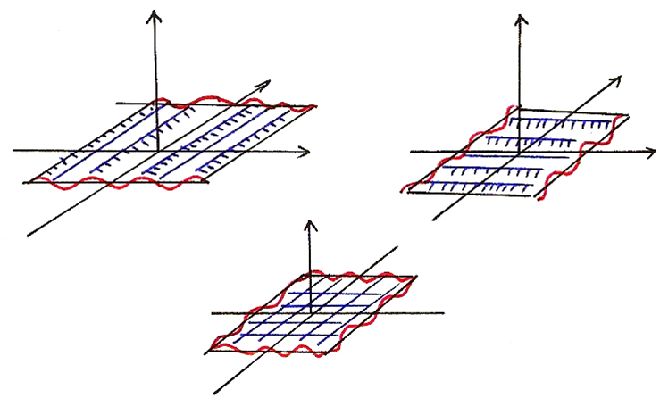









Problem 3.70, p.281 of text
2-dimensional signals
$$e^{jω_{1}t_{1}}$$
$$e^{jω_{2}t_{2}}$$
$$t_{2}$$
$$t_{2}$$
$$t_{1}$$
$$t_{1}$$
$$t_{2}$$
$$e^{j(ω_{1}t_{1}+ω_{2}t_{2})}$$
$$t_{1}$$

